Slide 1
FULSTON MANOR
Year 11 GCSE Parents’ Evening
Wednesday, 1st February 2017
7:00 pm
Millennium Hall

Slide 2
Where are we now?
How is my child doing?
How is the school supporting progress?
How can parents support progress?
Examinations
Post 16 Progression

Slide 3
YOUR CHILD SAT AN EXAM CALLED

Slide 4
Where are we now?
English
Maths
Science
Options

Slide 6
All students have unlimited, free access to the Pixl Lit App, which provides revision games and activities for English Literature subjects
Login Details: School ID = FM930 Username = surname and first initial in capital letters (MULLIGANJ, for example) Password = password

Slide 7
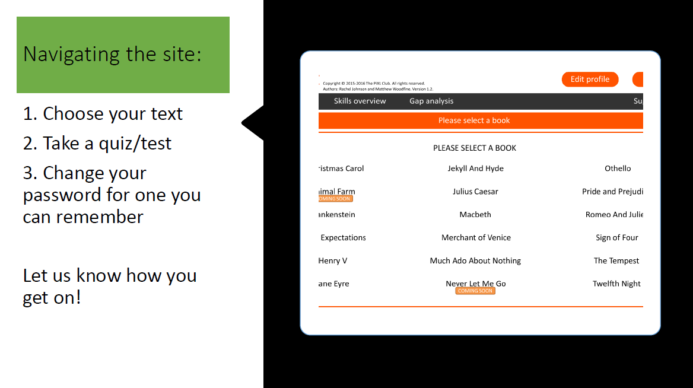

Slide 8
PiXL Maths App

Slide 9
Access – desktops, phones and tablets

Slide 11
Logging in
School ID: FM930
User ID: Initial then surname. Example: JSMITH
User Password: first name JOHN
Passwords can be changed after initial login

Slide 12
Complete tasks or design your own test

Slide 13
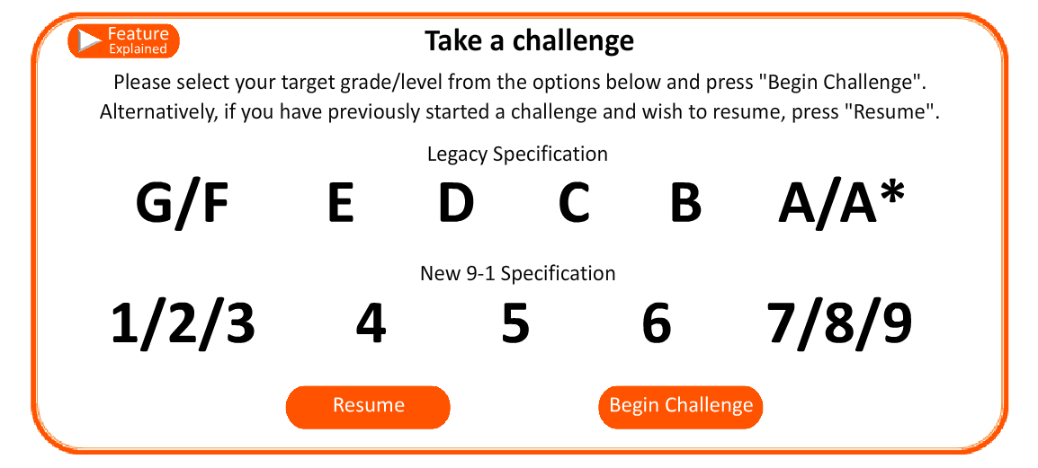
Take a challenge

Slide 14
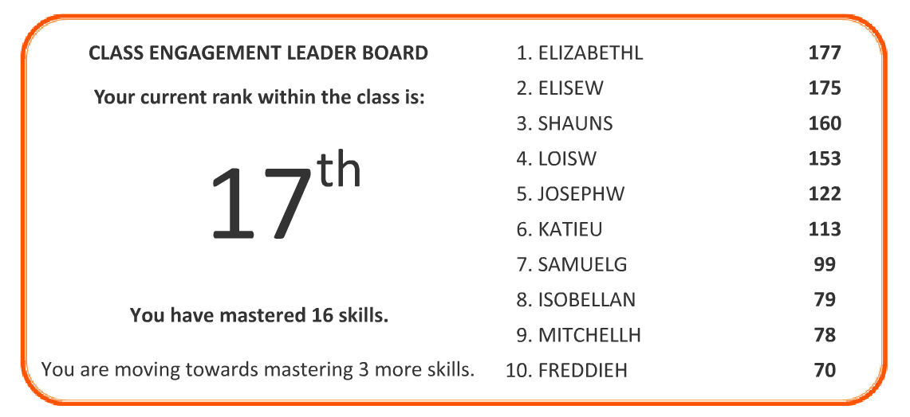
Check your ranking

Slide 15
Skills overview

Slide 16
Equipment checklist for all maths lessons
Pen, pencil, rubber, ruler, sharpener
Geometry set
Calculator

Slide 17
Science Made Simple
Examination board | OCR Gateway
Which examination is my child taking? | Triple Science students: OCR Gateway Biology http://www.ocr.org.uk/qualifications/gcse-gateway-science-suite-biology-b-j263-from-2012/ Triple Science students: OCR Gateway Chemistry http://www.ocr.org.uk/qualifications/gcse-gateway-science-suite-chemistry-b-j264-from-2012/ All other students in Year 11: OCR Additional Science http://www.ocr.org.uk/qualifications/gcse-gateway-science-suite-additional-science-b-j262-from-2012/
Where can I get hold of revision materials? | The school shop sells revision guides for the various courses. BBC Bitesize is a useful resource containing information, video clips and quizzes.
Where can I get hold of past papers? | The links above take you to specific webpages which contain past examination papers and the mark schemes.
Why did my child take a GCSE in Science at the end of last year? | Science currently exists as at least 2 separate GCSE qualifications which together form the science qualification (Double or Triple Science). Last year students took Core Science (Double Award) or Physics (Triple Award).
Is my child re-taking their Year 10 qualification? | Most students in 11UL and 11GCR will be entered for the resit. Some students in other groups (including Triple) have also been entered.

Slide 18
Business Studies,
Business Communications, Economics and Personal Finance Unit 3
The next 4 slides, clearly outline the structure of the answers required in the examinations to gain the maximum marks with example answers to show how marks are awarded.
By following the instructions and steps, the students should be able to gain the marks in a clear and logical manner.

Slide 20
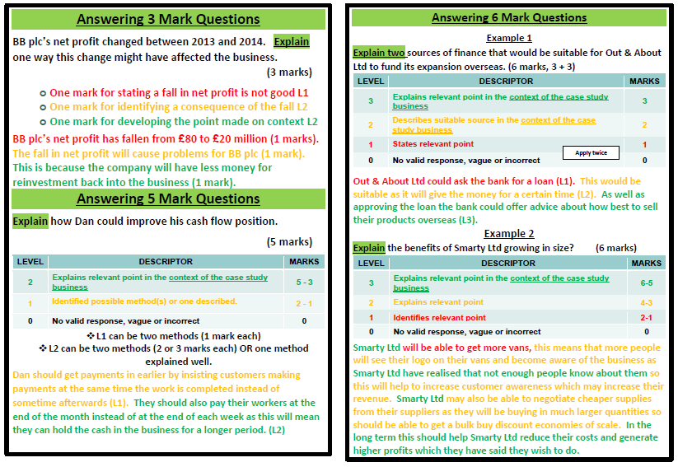

Slide 23
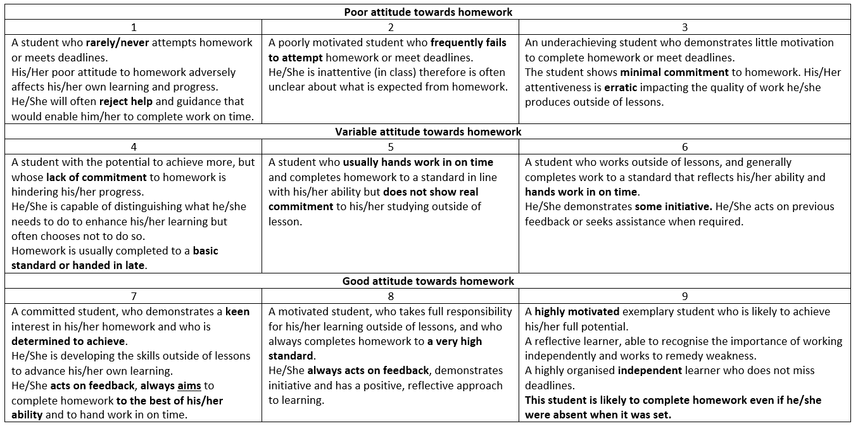
Attitude to Homework Grades

Slide 24
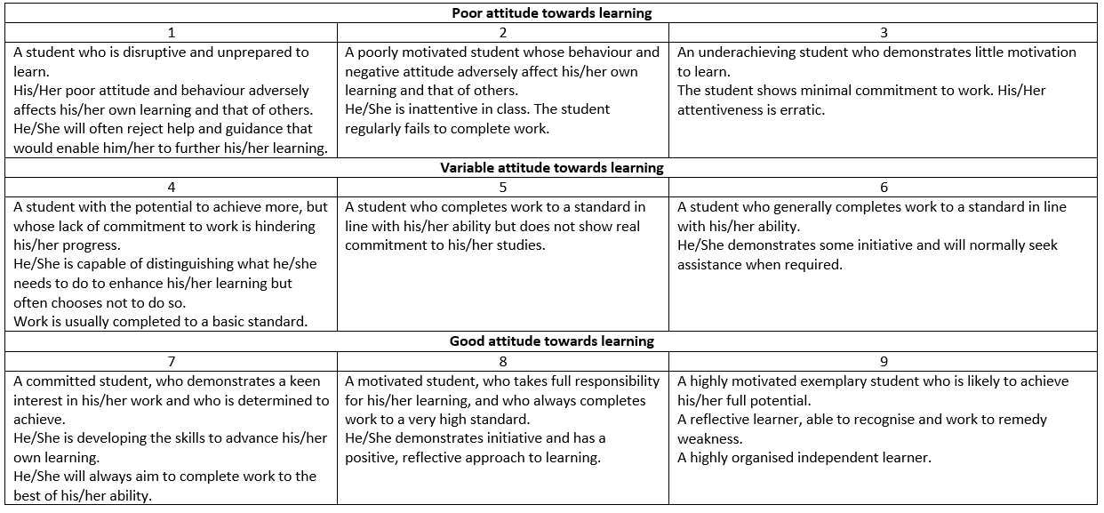
Attitude and Attainment Grades

Slide 25
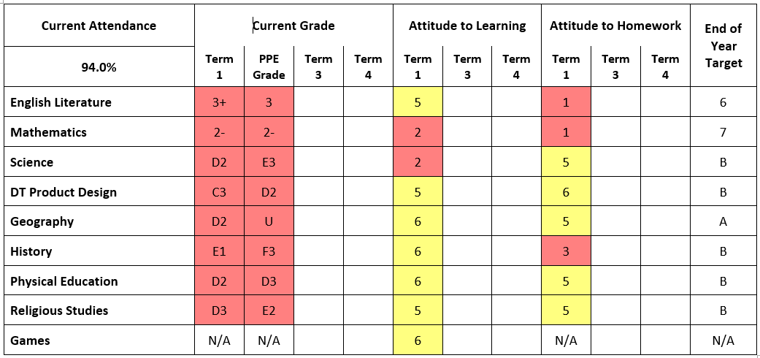
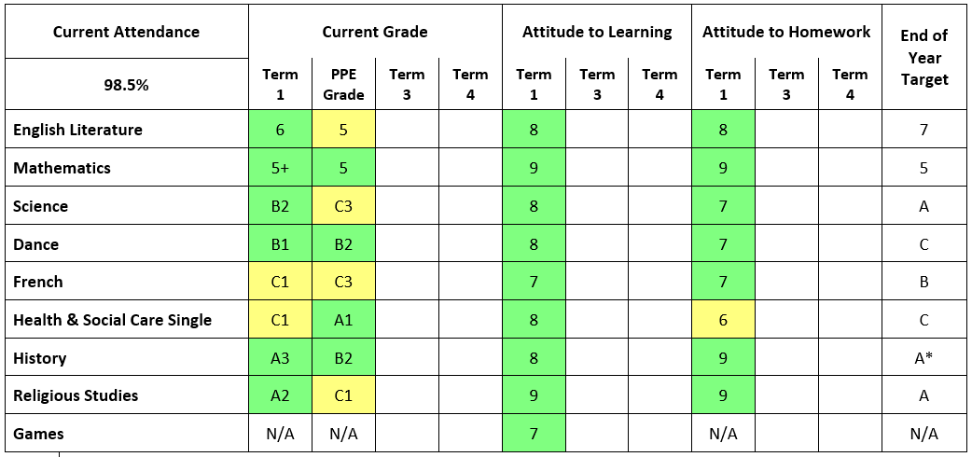
-2.48
+1.42
Notes:
Tom Calladine (A8 = B/6/7)& Lauren Damiral (A8 = B/C/4/5)

Slide 26
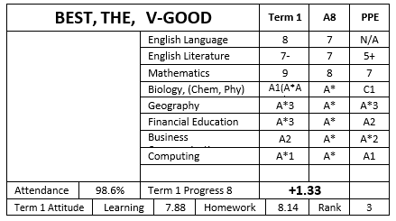
To gain this positive Progress 8 this student must gain these grades in the actual exams.
Beware
of
Fine-Grade 3
Term 1 attainment grades from the teachers
The best grade from English is doubled. So contributes 2 grades toward the Progress 8 score.
Year 11 (Year 10)
The Maths grade is doubled. So contributes 2 grades toward the Progress 8 score.
+0.39 means the student is working about 4 (3.9) grades above expected
This student needs to focus on the low fine grades (A3 and A*3)
How do the attainment grades compare to the expected grades?
Each 0.1 is the equivalent to one grade.
Notes:
Rian Leggit
Opportunity to mention school expectations versus external estimate

Slide 27
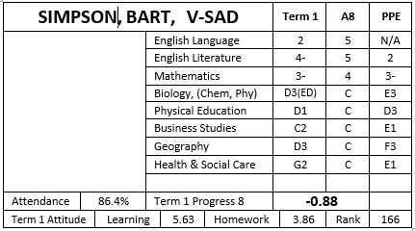
This student has a negative Progress 8, they are underachieving.
They are at even greater risk because some of the estimates have low fine-grades.
Beware
of
Fine-Grade 3
Current attainment grades from the teachers
The best grade from English is doubled. So contributes 2 grades toward the Progress 8 score.
Year 11 (Year 10)
P1 = Level 1 Pass (D grade)
P2 = Level 2 Pass
(C grade)
M2 = B grade
D2 = Distinction
A grade
D*2 = Distinction*
A* grade
The Maths grade is doubled. So contributes 2 grades toward the Progress 8 score.
-0.88 means that this student would have to improve by at least 1 grade in 8 subjects or two grades in 4 subjects
How do the attainment grades compare to the expected grades?
Each 0.1 is the equivalent to one grade.
Notes:
Frazer Alan

Slide 28
Year 11 Workshops 2016/17
Week 1
Monday | Tuesday | Wednesday | Thursday | Friday
History/Enterprise | English | Independent Study | Maths | Science
Week 2
Monday | Tuesday | Wednesday | Thursday | Friday
Computing Dance Economics French | Art Business Studies Business Communications Citizenship Textiles Drama | Independent Study | Creative Media Graphic Products Physical Education Religious Studies | Financial Studies Geography Health and Social Care Music Product Design

Slide 29
Holiday Workshops Feb. 2017
Holiday: 13th – 17th February 2017
Monday 13th February
Year Group | Subject | Students | Times | Staff | Rooms
Year 11 | Mathematics | By invitation letter | 08:50 – 15:00 | Winchmore Tutors | N1, N2, N5, N16, N15, N14
Tuesday 14th February
Year Group | Subject | Students | Times | Staff | Rooms
Year 11 | Mathematics | By invitation letter | 08:50 – 15:00 | Winchmore Tutors | N1, N2, N5, N16, N15, N14
Wednesday 15th February
Year Group | Subject | Students | Times | Staff | Rooms
Year 11 | Mathematics | By invitation letter | 08:50 – 15:00 | Winchmore Tutors | N1, N2, N5, N16, N15, N14

Slide 30
Holiday Workshops Feb. 2017 Continued
Holiday: 13th – 17th February 2017
Thursday 16th February
Year Group | Subject | Students | Times | Staff | Rooms
11 | Art | All students | 10:00 – 14:00 | JLS, SRA, LRE | Y5, Y6, Y7, Y8
11 | Textiles | All students | 10:00 – 14:00 | HRO | Y4
12/13 | DT | All students | 09:00 – 13:00 | MWH, CFK, ALA | Y1, Y2, Y3
Friday 17th February
Year Group | Subject | Students | Times | Staff | Rooms
11 | PD / GP | All students | 09:00 – 13:00 | MWH, CFK, ALA | Y1, Y2, Y3

Slide 31
Revision is a three step process
Revision guides
Learn the facts sheets
Past examination papers
Knowledge:
Revise the basic facts
Understanding: Describe and explain the knowledge
Application:
Apply the knowledge to an examination question
Can they explain it to you? To each other?

Slide 32
Where can I find past papers?
Link:
On the Year 11 tab, under past papers

Slide 33
How to revise ‘actively’
The Cornell System
Blank A4 Paper
Notes
Write the revision notes in this space here
5cm
4cm
Key questions
Look at the key words and key phrases. Devise some questions linked to them. Write them on this sheet.
Transfer your summary onto a cue card
Key points
Read through the notes you have made. Write down the key words and key phrases in this section
Summary
Write down a mini summary of the notes which appear in the box above. This must be in your own words. Include all the key words and phrases.
Notes:
ANNOTATED SLIDE: This is my adaptation of the Cornell system for note taking; the idea is that revision notes, mindmaps or bullet points are placed on the main part of the A4 paper that has been given a large margin and summary section at the bottom. The slide explains how to then use this paper for revision.

Slide 34
This student is making excellent progress in all of their subjects, this is their behaviour log record since August.

Slide 35
This student is making just below expected progress – all of the negative entries are for a lack of homework.

Slide 36
This student is making below expected progress. This is their behaviour record.

Slide 37
GCSE Examinations - 2017
Morning exams start at 9.15am – Afternoon exams start at 1.45pm unless otherwise stated. Please arrive 15 minutes before the scheduled start time. See practical exam poster for confirmed dates and times of when all practical exams are taking place
Date | Subject | Code | Duration | am/pm
TBA | Drama Preparation Day
TBA | Drama Preview performance
TBA | Drama Performance
TBA | Music Final Performance
Wednesday 22nd February | Physical Education Analysis of Performance interviews
28th & 29th February | Physical Education Moderation
16th & 17th March | Art & Textiles Preparation Days
21st & 22nd March | Art & Textiles Examination Days
Monday 8th May | Dance Moderation
Continued/………….

Slide 38
GCSE Examinations - May 2017
Morning exams start at 9.15am – Afternoon exams start at 1.45pm unless otherwise stated. Please arrive 15 minutes before the scheduled start time. See practical exam poster for confirmed dates and times of when all practical exams are taking place
Date | Subject | Code | Duration | am/pm
Monday 15th May | Certificate in Financial Education | FCWE | 1 hour | am
 | Citizenship paper 1 | 41051 | 1 hour | pm
Tuesday 16th May | BTEC First Award in Creative Digital Media | 21526 E01 | 1 hour | am
 | French Listening Higher & Foundation | 46551F/H | 35 mins / 45 mins | am
 | French Reading Higher & Foundation | 46552F/H | 30 mins / 50 mins | am
Wednesday 17th May | Religious Studies paper 1 | 40552 | 1 hour 30 mins | pm
Thursday 18th May | Citizenship paper 2 | 41053 | 1 hour | pm
Friday 19th May | Physical Education | 5PE01/01 | 1 hour 30 mins | pm
Continued/………….

Slide 39
GCSE Examinations - May 2017
Morning exams start at 9.15am – Afternoon exams start at 1.45pm unless otherwise stated. Please arrive 15 minutes before the scheduled start time. See practical exam poster for confirmed dates and times of when all practical exams are taking place
Date | Subject | Code | Duration | am/pm
Monday 22nd May | English Literature unit 1 | 8702/1 | 1 hour 45 mins | am
 | Geography Foundation & Higher paper 1 | 5GB/1F/1H | 1 hour 15 mins | pm
Tuesday 23rd May | Religious Studies paper 2 | 40553 | 1 hour 30 mins | pm
Wednesday 24th May | Business Studies paper 1 | 413001 | 1 hour | am
 | Biology paper 1 | B731 | 1 hour 15 mins | pm
 | Science B paper 1 (resits) | B711/F/H | 1 hour 15 mins | pm
Thursday 25th May | Maths paper 1 non calculator | 1MA1/1F/1H | 1 hour 30 mins | am
 | Core Latin Language Level 2 | 9521/01 | 1 hour 15 mins | pm
Continued/………….

Slide 40
GCSE Examinations - May 2017
Morning exams start at 9.15am – Afternoon exams start at 1.45pm unless otherwise stated. Please arrive 15 minutes before the scheduled start time. See practical exam poster for confirmed dates and times of when all practical exams are taking place
Date | Subject | Code | Duration | am/pm
Thursday 25th May | Maths paper 1 non calculator | 1MA1/1F/1H | 1 hour 30 mins | am
 | Core Latin Language Level 2 | 9521/01 | 1 hour 15 mins | pm
Friday 26th May | English Literature unit 2 | 8702/2 | 2 hour 15 mins | am
Monday 5th June | Economics paper 1 | 413011 | 1 hour 15 mins | pm
 | History paper 1 | 5HB01(1B) | 1 hour 15 mins | am
 | Roman Civilisations Topics Level 2 | 9522/01 | 1 hour | pm
Tuesday 6th June | English Language unit 1 | 8700/1 | 1 hour 45 mins | am
 | Geography Foundation & Higher paper 2 | 5GB/2F/2H | 1 hour 15 mins | pm
Continued/………….

Slide 41
GCSE Examinations - May 2017
Morning exams start at 9.15am – Afternoon exams start at 1.45pm unless otherwise stated. Please arrive 15 minutes before the scheduled start time. See practical exam poster for confirmed dates and times of when all practical exams are taking place
Date | Subject | Code | Duration | am/pm
Wednesday 7th June | Computing | A451/01 | 1 hour 30 mins | am
Thursday 8th June | Maths paper 2 calculator | 1MA1/2F/2H | 1 hour 30 mins | am
 | Economics paper 2 | 413012 | 1 hour 15 mins | pm
Friday 9th June | Science B paper 2 (resits) | B712/F/H | 1 hour 30 mins | am
 | Chemistry paper 1 | B741 | 1 hour 15 mins | am
 | Music unit 3 | 5MU03/01 | 1 hour 30 mins | pm
 | Business Studies paper 2 | 413002 | 1 hour | pm
Continued/………….

Slide 42
GCSE Examinations - May 2017
Morning exams start at 9.15am – Afternoon exams start at 1.45pm unless otherwise stated. Please arrive 15 minutes before the scheduled start time. See practical exam poster for confirmed dates and times of when all practical exams are taking place
Date | Subject | Code | Duration | am/pm
Monday 12th June | English Language unit 2 | 8700/2 | 1 hour 45 mins | am
 | Health and Social Care | A912/01 | 1 hour | pm
 | Geography Foundation & Higher paper 3 | 5GB/3F/3H | 1 hour 30 mins | pm
Tuesday 13th June | Maths paper 3 calculator | 1MA1/3F/3H | 1 hour 30 mins | am
Wednesday 14th June | Additional Science paper 1 | B721/F/H | 1 hour 15 mins | am
 | Physics Paper 1 | B751 | 1 hour 15 mins | am
 | History paper 2 | 5HB02(2C) | 1 hour 15 mins | pm
Friday 16th June | Additional Science paper 2 | B722/F/H | 1 hour 30 mins | am
 | Biology paper 2 | B732 | 1 hour 30 mins | am
Continued/………….

Slide 43
GCSE Examinations - May 2017
Morning exams start at 9.15am – Afternoon exams start at 1.45pm unless otherwise stated. Please arrive 15 minutes before the scheduled start time. See practical exam poster for confirmed dates and times of when all practical exams are taking place
Date | Subject | Code | Duration | am/pm
Monday 19th June | Business & Communication Systems | 413008 | 1 hour | pm
 | Chemistry paper 2 | B742 | 1 hour 30 mins | am
Tuesday 20th June | History paper 2 | 5HB03(3A) | 1 hour 15 mins | am
 | Graphic products | 45501 | 2 hours | pm
Wednesday 21st June | Physics paper 2 | B752 | 1 hour 30 mins | am
 | Dance | 42301 | 1 hour | pm
 | Health and Social Care Double | A914 | 1 hour | pm
Monday 26th June | Product Design | 45551 | 2 hours | am

Slide 44
Calendar of Events
3rd November 2016 | Sixth Form Open Evening
Early November onwards | Online applications for courses commences. Acknowledgement of applications will be ongoing, as and when we receive them. Conditional offers will be sent out from early January onwards.
10th January 2017 5.00 p.m. – 7.00 p.m. | Year 11 Parents’ Evening. Subject teachers will give information on how each student is performing in the current courses. Sixth Form staff will be available to answer any questions concerning the Sixth Form.
End of January 2017 | Option Blocks will be produced, once sufficient applications have been received.
May – June 2017 | GCSE Examinations.
Week beginning 26th June 2017 | Sixth Form Induction Week. Students can try out their courses and be a Sixth Former for the week.
Thursday, 24th August 2017 | GCSE results, accompanied by a letter confirming course place or invitation to discuss other options.
24th, 25th, 29th and 30th August 2017 | There will be interviews for students who need to discuss course choices.
Early September 2017 | Begin courses.

Slide 45
Post 16 Applications
All 6th Form and College applications should be made online using www.ucasprogress.com
Students who have forgotten/lost their login details should see Mrs Farr in the 6th Form Centre.
Applications for apprenticeships and jobs with training need to be made direct, rather than online.
Whilst there is no absolute deadline, you are more likely to get your chosen courses if you apply early.

Slide 46
Successful Students
Time in school – Successful students, as well as working hard in every lesson, actively seek out their teachers for extra help or explanation of areas they are finding difficult
Workshops – Successful students attend all relevant workshops, both after school and during holiday periods
Homework – Successful students complete at least 10 hours a week of homework and additional study in the period between now and their examinations
Organisation – Successful students plan their time carefully, establishing clear revision schedules, knowing the dates of all deadlines and examinations and focusing on those subjects in which they most need to make rapid progress

Slide 47
Successful Students
Support – Successful students regularly seek support from tutors and mentors to enable them to overcome any barriers to progress and follow advice given by all staff
Deadlines – Successful students not only meet deadlines but allow time for redrafting and improvement where possible
Revision – Successful students implement a range of different revision techniques, including the use of internet resources and past papers, to ensure that they are well prepared for all examinations
Urgency and Calmness – Successful students display a sense of urgency and purpose, remaining calm as exams approach because of the preparation that has been done in advance

Slide 48
A High Performing Business & Enterprise
and Training School
FULSTON MANOR
Year 11 GCSE Parents’ Evening
Wednesday, 1st February 2017
7:00 pm
Millennium Hall

